Slide 1
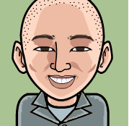
Engineering Owner
Willie Wang

Slide 2
Goals of Engineering Owner
Talent Management
Recruit
Mentor, Coach
Collaboration
Team Player
Extended Team
Execution
Deliver Projects
Retain
Servant Leader
Expectations
Communication
Transparency
Quality
Sustainability
Security
Build High Performance Eng Teams

Slide 3

Product Owner, Engineering Owner
Facilitate Ideation
How, When
Push the boundary
More, more, more
Roadmap
Why, What
Feasibility
Reliability, Quality, Security, Scalability
Technical Debt
Architecture
Prioritize Value

Slide 4
Project Mgr/ScrumMaster, Eng Owner
Remove Project Impediments
Remove Org Impediments
Facilitate
Team first
Team productivity
Individual Performance Issues
Enhance culture, process for productivity
Focus on Team
Focus on Environment

Slide 5
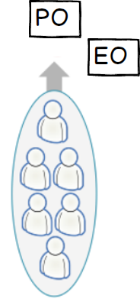
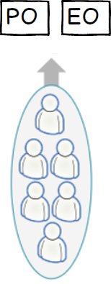
Engineering Owners
In a Product Team
Eng Projects
X
Single Backlog
EO focuses on Technical Debt (20%)
Writes or Reviews Technical Debt Stories
Collaborates with Product Owner
Impact assessment for Eng Projects
Technical in Nature
For Example: CLOG, Continuous Deployment, Jira, git, PI
Organization Technical Debt
Impact assessment

Slide 6
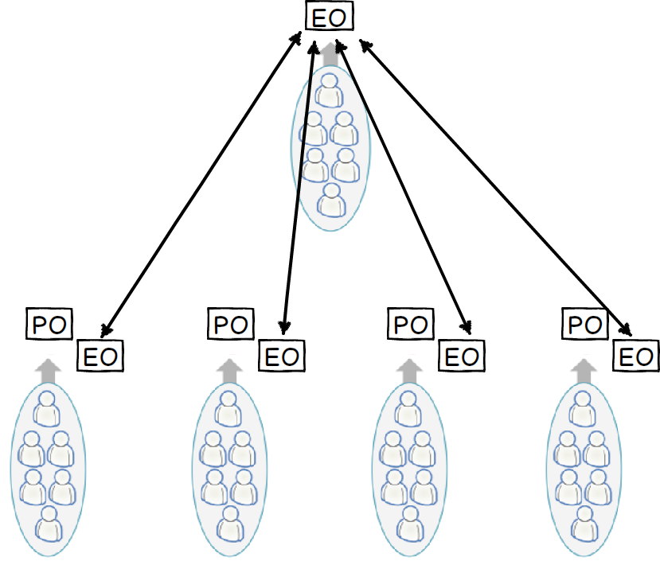
Cross Functional Projects

Slide 7
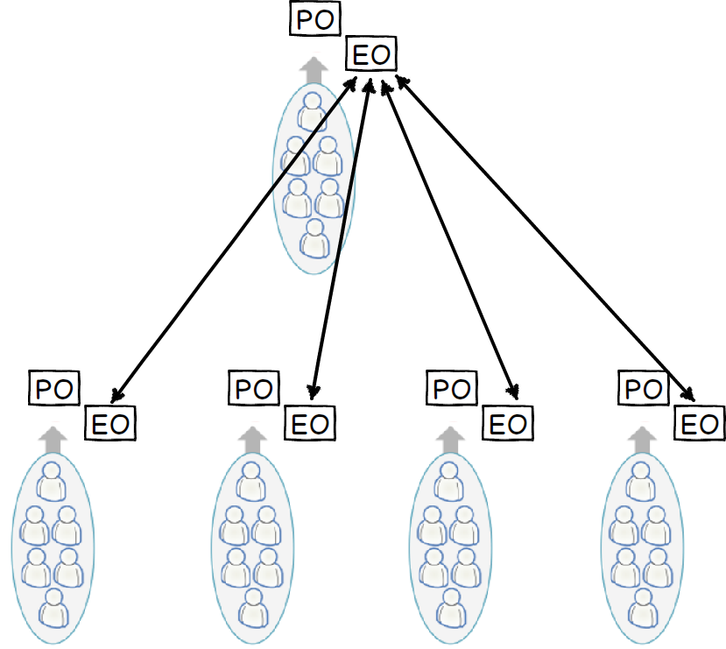
Cross Functional Projects

Slide 8
Eng Owner Roadmap Planning
Theme | 2Q15 | 3Q15 | 4Q15 | 1Q16
Shopping | Top of funnel optimizations Tax QLE SEO improvements | Wizard 2.0 Responsive SEO pages Top of funnel optimizations Retest- delayed account creation | SEP during OEP Top of funnel optimizations SEO improvements
Ancillary/Sponsorship | Responsive Mobile Design for Short-term Cross sell guaranteed issue ST on ST decline | Responsive Mobile Design for Dental New GAP shopping line | Apply redesign to Acc and Ctl New AD&D page | Responsive Mobile Design for Vision
Tools, Bugs & Tech Debt | Doctor details- SEO test Move quote page to not use sessions Move plan details to MVC Migrate all traffic to new house home/census | Move quote page to MVC Move cart page to MVC Migrate all traffic to new house quote/plan details | Reduce server calls per page
INCLUDE BOTH PRODUCT AND ENG ORGANIZATIONAL DEBT

Slide 9
Tactical -> Strategic
Days
Months
Tactical
Strategic
Eng Owner

Slide 10
Strategic Planning – Eng Owner
We will add 10+ Medicare Carrier Integrations AEP 2016
Do we have enough knowledgeable Carrier Integration Specialists?
Early Planning for no National Days
Puts and Takes for more Resources
Budget Planning to Hire more Resources
More QA, Engineers during Sept -> Oct 2016

Slide 11
Time Management
 | Urgent | Not Urgent
Important | Quadrant I Urgent & Important 30% | Quadrant II Not Urgent & Important 60%
Not Important | Quadrant III Urgent & Not Important 10% | Quadrant IV Not Urgent & Not Important 0%

Slide 12
Examples of Quadrant II Activities
Leadership
Coaching, Mentoring
Retrospectives
Technical
Continuous Deployment
Technology selection, Architecture
Team
Inspire, Morale building
Agile, Innovation Culture
Technical Vision
Trust, Transparency, Engagement
Quickstart, Training

Slide 13
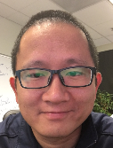
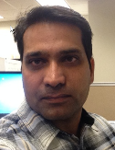
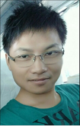
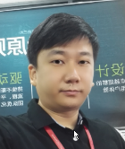
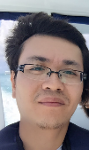
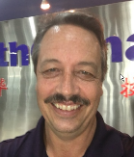
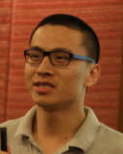
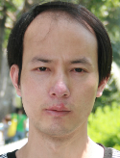

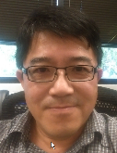
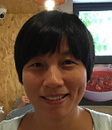
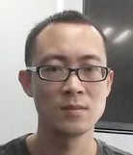
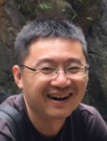
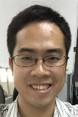
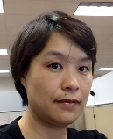
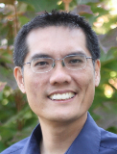
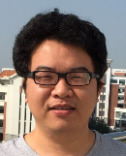
Engineering Owners

Slide 14
Individual Contributors

Slide 15

Ask Questions and Speak Up

Slide 16
“When I look back on the not-so-pleasant experiences in my career and life, on every single occasion I can identify where I held back from confronting an issue when I shouldn’t have because I was afraid someone might think I was being difficult, hard to get along with, uncooperative or pushy. I was trying to be a nice person—agreeable, easy to work with. Alas, I was trying too hard.”

Slide 17
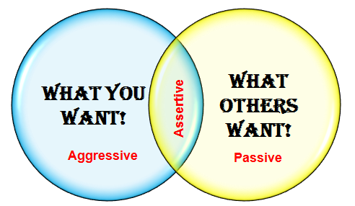
Radical Candor
No Man/Woman
Yes Man/Woman

Slide 18
Amazing Engineer
Traits | Examples
Ownership | I totally own this, and will get it done.
Problem Solver | Let's put our heads together to solve this problem.
Fearless | This project is so big, complicated, and have so many unknowns...great, let's go tackle it!
Teamwork | I can produce much better results with my team than just by myself.
Curiosity | Never seen this before…how does this work? Let me tinker with it until I figure it out.
Enabler | I want to help my teammates be successful as well…how can I remove roadblocks?
Craftsman | I take pride in creating a polished product…I create tools to get there.
Data Driven | So many decisions to make, let’s get the data
Planner | I can break it down, estimate scope and track progress

Slide 19

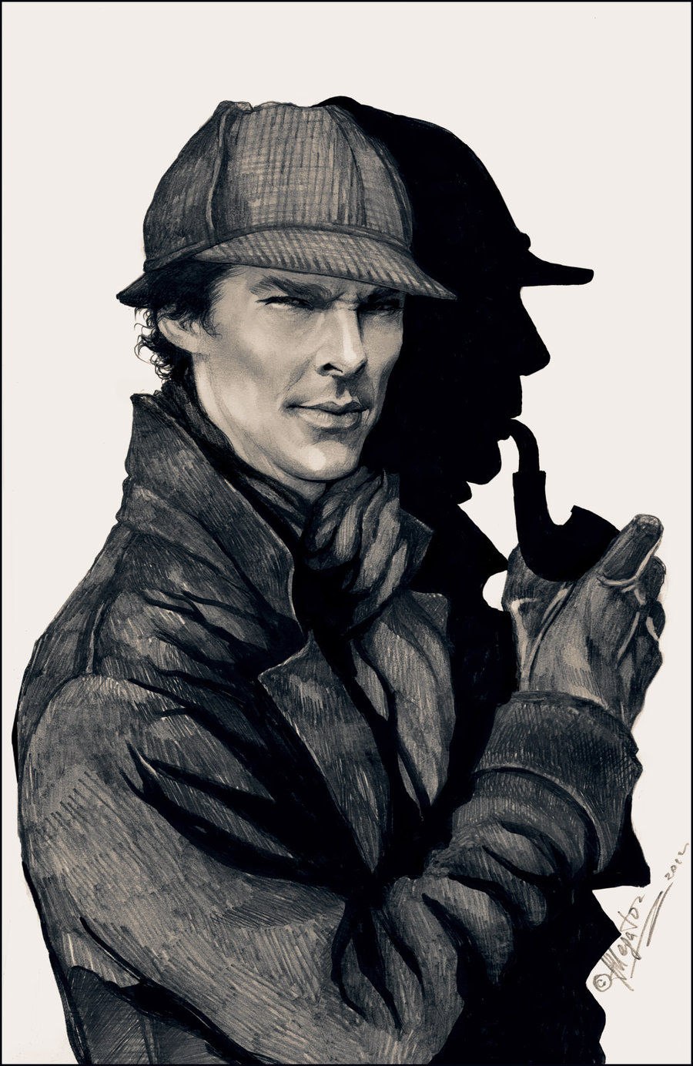


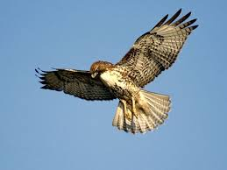
Amazing QA
Traits | Examples
Product Expert | Expert in the product, understand how it interacts with other systems Advocate for our customers
Detective | Root cause analysis, want to know why, ask questions How did the issue happen? How can we improve and do better
Trusted Friend | Giving honest difficult feedback with tact and diplomacy Understanding & Team focused
Great Communicator | Clear and concise in Jira, Reports, Emails Good Listener
Hawk | Strong attention to detail Situational Awareness – knowing how to judge the Priority of an issue Good judgment to assess high risk areas

